Slide 1


Final Year Project
Multi-Purpose AI Password Analysis Tool
(Offensive and Defensive AI Warfare)
Supervised By: Dr. Muhammad Mansoor Alam

Slide 2
Project Team
Osama Khalid (27971)
Sardar M. Zeeshan khan (27969)
Salman Ali (27667)

Slide 3
Table of Contents
Background and Introduction
Market Survey
Problem Statement
Project Scope
Proposed Solution
Requirements Summary
Design Summary
Methodology
Implementation Summary
Experiments and Results Summary
Testing Summary
Conclusion and Outlook

Slide 4
"The only truly secure system is one that is completely powered off, cast in concrete, and sealed in a lead-lined box buried a mile underground ."
-Bruce Schneier (Security Expert)

Slide 5
BACKGROUND AND INTRODUCTION

Slide 6
Background
Passwords are the primary method of securing sensitive data and online accounts.
Weaknesses in password practices such as predictable patterns and human error pose significant risks.
Traditional password policies and manual security checks often fail to combat sophisticated cyberattacks.
Brute-force methods systematically guess all possible password combinations.
Highly time-consuming and computationally expensive, especially for complex passwords.

Slide 7
Introduction Multi-Purpose AI Password Analysis Tool
Offensive Applications
Make use of password comparison and top tiered algorithms to best get over passwords within a range and only when permitted.
Defensive Applications
Automatic password strength, perceived words identification, and patterns finding with AI.

Slide 8
Market Survey

Slide 9
Tools | John the Ripper | RainbowCrack | OphCrack | L0phtCrack | Aircrack-ng
Type | Password Cracker | Password Cracker | Password Cracker | Password Cracker | Wi-Fi Network Security Tool
Supported Platforms | Windows, Linux, macOS | Windows, Linux | Windows, Linux | Windows | Linux, macOS
Password Hashes Supported | Various (Unix, Windows, etc.) | LM, NTLM, MD5, SHA1, SHA256, SHA512 | LM, NTLM | LM, NTLM | WEP, WPA, WPA2
Attack Methods | Dictionary, Brute Force, Hybrid | Precomputed Hash Tables | Rainbow Tables, Brute Force | Dictionary, Brute Force | Dictionary, Brute Force, WPS PIN
Speed | Fast | Depends on Rainbow Table size | Moderate | Fast | Depends on hardware and complexity of the password
User Interface | Command Line | Command Line | GUI | GUI | Command Line
License | Open Source | Freeware | Open Source | Commercial | Open Source
Usage | Penetration Testing, Password Auditing | Password Cracking | Password Recovery | Password Cracking | Wi-Fi Network Security Testing

Slide 10
Problem Statement

Slide 11
Problem Statement
With increasing password complexity requirements, brute-force attacks become significantly slower and less efficient.
Users often employ longer and more complex passwords (e.g., 8+ characters, combination of uppercase, lowercase, symbols) making traditional brute-force methods impractical.

Slide 12
4^(26+26)=20282409603651670423947251286016

Slide 13
Length | Upper Case | Upper +Lower Case | Upper+Lower+Numeric | Upper+Lower+Numeric+Special Char
4 | 4.5036E+15 | 2.02824E+31 | 2.12676E+37 | 3.92319E+56
5 | 1.49012E+18 | 2.22045E+36 | 2.1684E+43 | 5.04871E+65
6 | 1.70582E+20 | 2.90981E+40 | 1.75945E+48 | 1.40029E+73
7 | 9.38748E+21 | 8.81248E+43 | 2.48931E+52 | 2.74926E+79
8 | 3.02231E+23 | 9.13439E+46 | 9.80797E+55 | 7.77068E+84
9 | 6.46108E+24 | 4.17456E+49 | 1.45558E+59 | 4.998E+89
Length | Combinations
4²⁶⁺²⁶ | 2220446049250313080847263336181640625
4²⁶⁺²⁶⁺¹⁰ | 21267647932558653966460912964485513216
5²⁶⁺²⁶ | 29098125988731506183153025616435306561536
5²⁶⁺²⁶⁺¹⁰ | 21684043449710088680149056017398834228515625

Slide 14
Length | Upper Case | Upper + Lower Case | Upper + Lower + Numeric | Upper + Lower + Numeric + Special Char
4 | 4.5036E+15 | 2.02824E+31 | 2.12676E+37 | 3.92319E+56
5 | 1.49012E+18 | 2.22045E+36 | 2.1684E+43 | 5.04871E+65
6 | 1.70582E+20 | 2.90981E+40 | 1.75945E+48 | 1.40029E+73
7 | 9.38748E+21 | 8.81248E+43 | 2.48931E+52 | 2.74926E+79
8 | 3.02231E+23 | 9.13439E+46 | 9.80797E+55 | 7.77068E+84
9 | 6.46108E+24 | 4.17456E+49 | 1.45558E+59 | 4.998E+89

Slide 15
Project Scope

Slide 16
Project Scope
Defensive capabilities
Password Strength Assessment: Analyze password complexity, identify dictionary words, and check for patterns using AI.
Optional Breach Checking: Integrate with online databases to verify if entered passwords and email IDs have been exposed in known data breaches.
Offensive capabilities (for ethical purposes only)
AI-powered password cracking: Utilize correlation of password data and advanced algorithms to efficiently crack passwords within a specified scope and with proper authorization.

Slide 17
"Your password is the key to your digital life. Choose it wisely, and guard it fiercely."

Slide 18
Proposed Solution

Slide 19
Proposed Solution
Our AI-powered tool leverages advanced algorithms and Human like passwords data to
Focus cracking efforts on statistically probable password patterns: This reduces the search space and accelerates the cracking process compared to traditional brute-force methods.
Analyze password strength based on complexity metrics and AI-driven pattern recognition: This identifies potential weaknesses in complex passwords, aiding in targeted cracking attempts.

Slide 20
Proposed Solution
BENEFITS
Reduced cracking time: This capability empowers security professionals to perform penetration testing and ethical hacking more efficiently, uncovering potential password-related vulnerabilities.
Improved vulnerability assessment: By analyzing password strength and identifying patterns, the tool provides valuable insights for organizations to strengthen their password policies and overall security posture.

Slide 21
Endeavour
Describe the Software development process
Data Preparation: Downloaded and filtered large datasets, splitting them into manageable chunks for efficient use.
Model Training: Trained the AI model over 3-4 months, optimizing performance.
GUI Development: Created separate GUIs for both modules to enhance user interaction.
Model Testing: Tested the model, achieving an accuracy rate of 70-80%.

Slide 22
WBS # | WBS Deliverable | Activity # | Activity to Complete the Deliverable | Responsible Team Member(s) & Role(s)
1 | Requirements | 1.1 | Hardware Requirements | Osama Khalid
 |  | 1.2 | Software Requirements | Osama Khalid Zeeshan Khan Salman Ali
2 | Phase 1: Develop and Train the AI Model | 2.1 | Research and select appropriate AI algorithms for password analysis. | Osama Khalid Zeeshan Khan Salman Ali
 |  | 2.2 | Acquire or prepare relevant password datasets for training. | Osama Khalid Zeeshan Khan Salman Ali
 |  | 2.3 | Train and optimize the chosen AI model with the selected datasets. | Osama Khalid
3 | Phase 2: Implement Core Functionalities | 3.1 | Design and develop functionalities for password strength analysis. | Osama Khalid
 |  | 3.2 | Develop functionalities for automated password cracking (ethical considerations apply). | Osama Khalid
4 | Phase 3: Design and Develop User Interface | 4.1 | Design a user-friendly interface for both offensive and defensive functionalities. | Salman Ali Zeeshan Khan
 |  | 4.2 | Integrate the trained AI model and core functionalities into the user interface. | Osama Khalid
5 | Phase 4: Testing and Refinement | 5.1 | Conduct thorough testing of all functionalities with various password scenarios. | Osama Khalid Zeeshan Khan Salman Ali
 |  | 5.2 | Refine the AI model, user interface, and functionalities based on testing results. | Osama Khalid
 |  | 5.3 | Document user manuals and instructions for the completed tool. | Osama Khalid Zeeshan Khan Salman Ali

Slide 23
Requirements Summary
Functional Requirements
Password Generation.
Password Cracking
Password Strength Analysis
Non-Functional Requirements
Performance
Scalability
Security
Usability
Reliability

Slide 24
Design Summary
Data preprocessing (Splitting, Filtering)
Training of the AI model.
AI model (RNN) for password cracking and analysis.
Integration with Hashcat tool.
GUI for user interaction.
Integration of the AI model with GUI

Slide 25
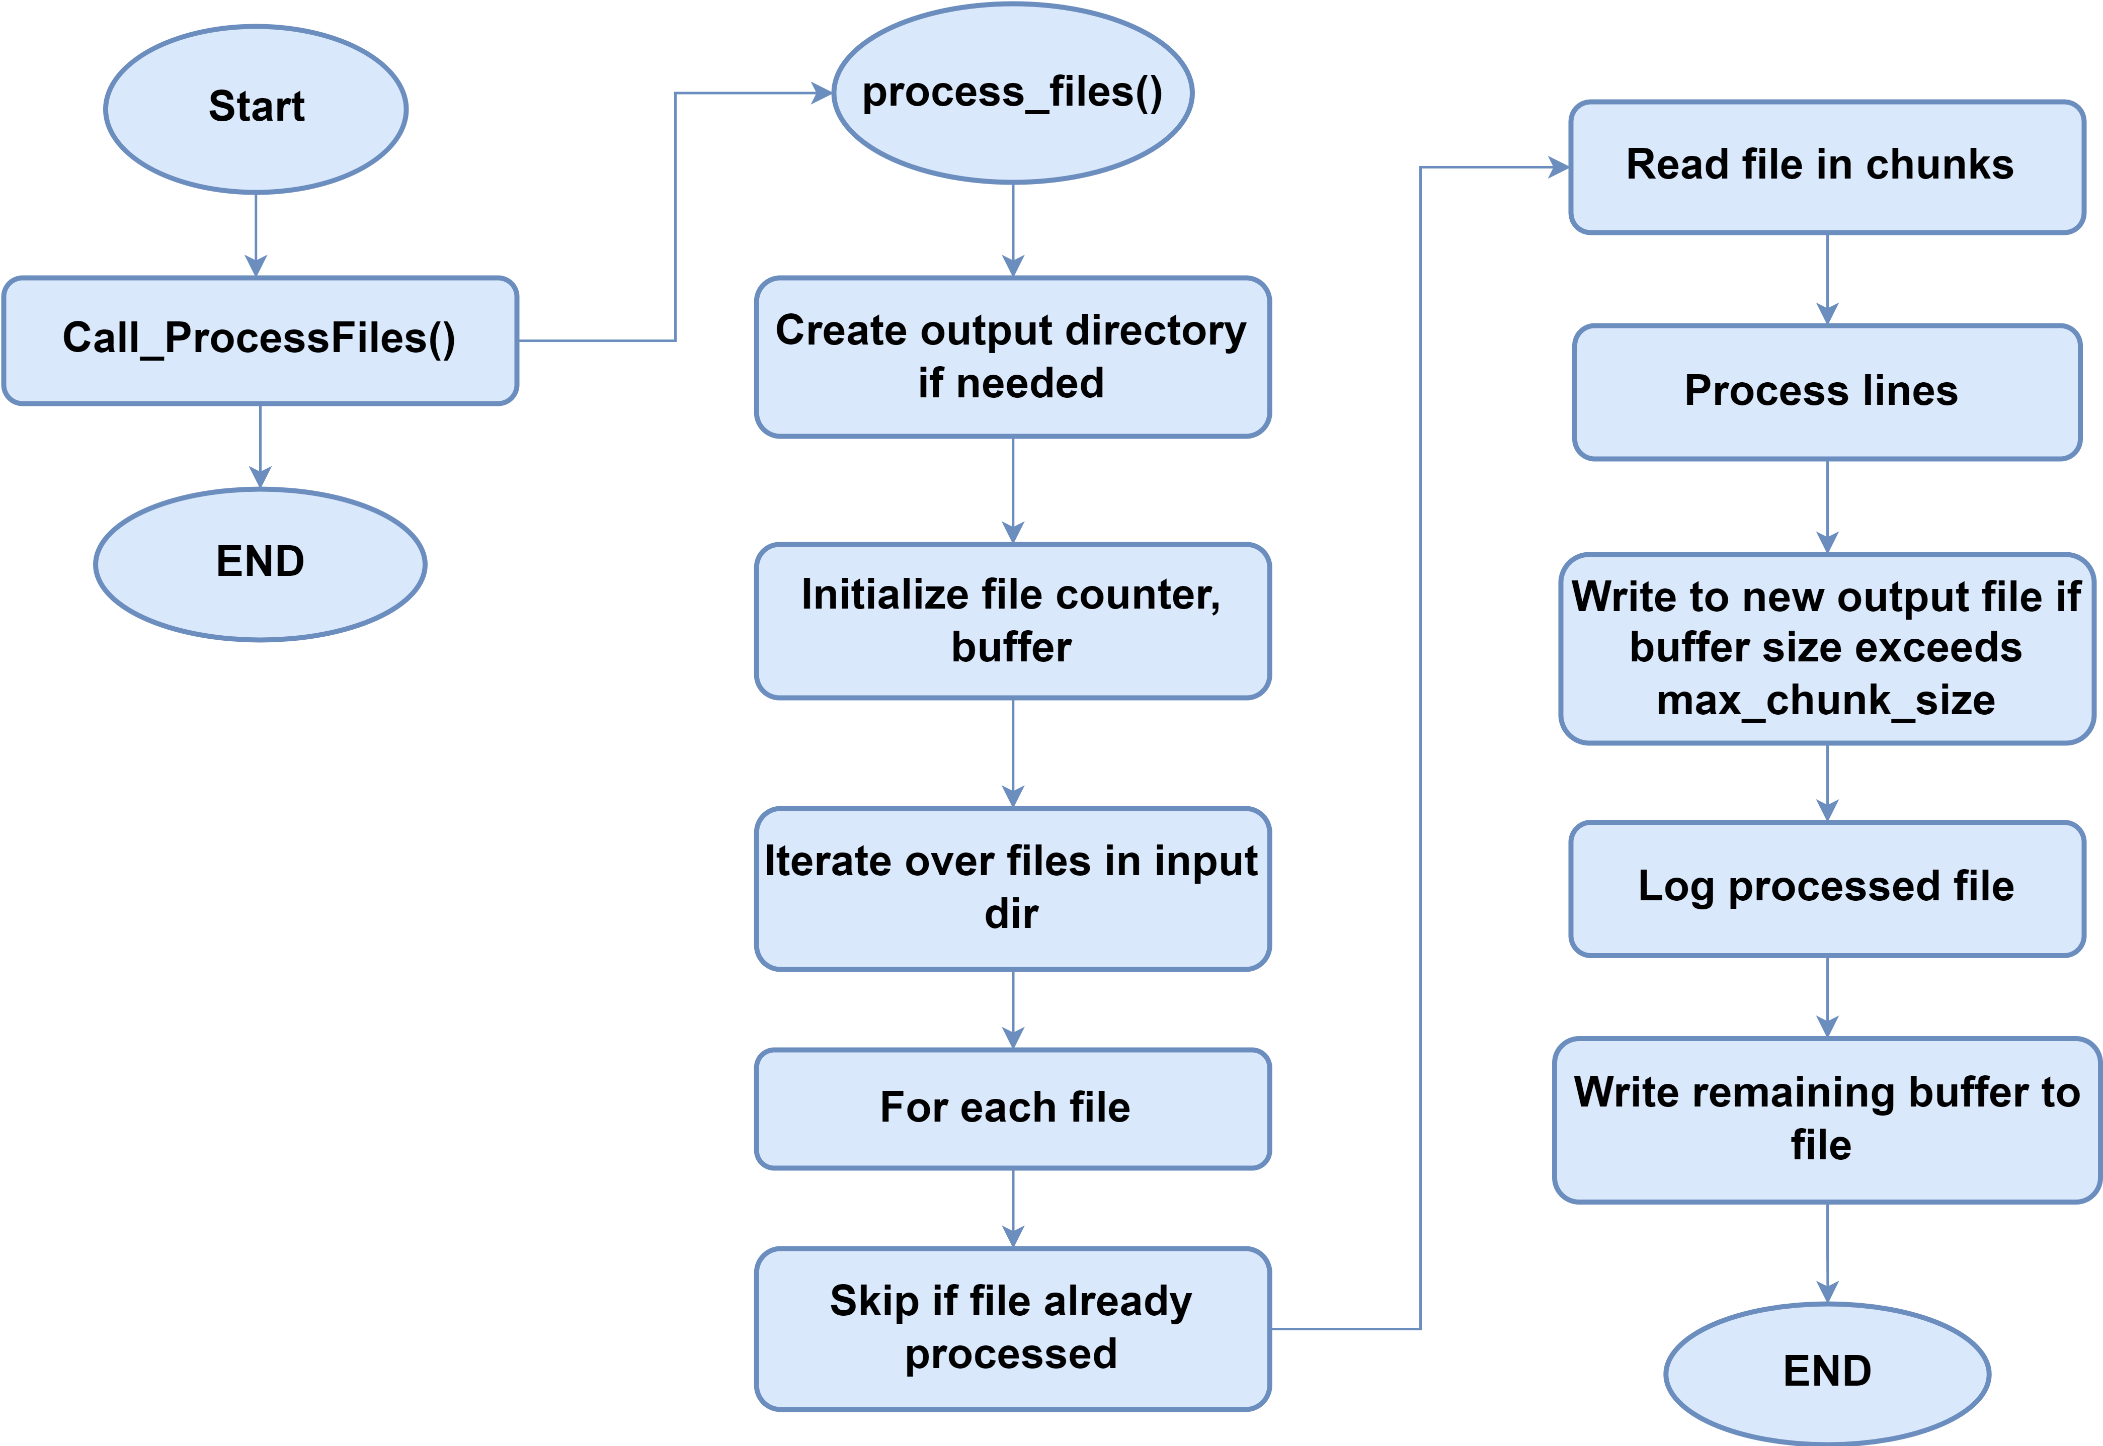
Data Splitting

Slide 26
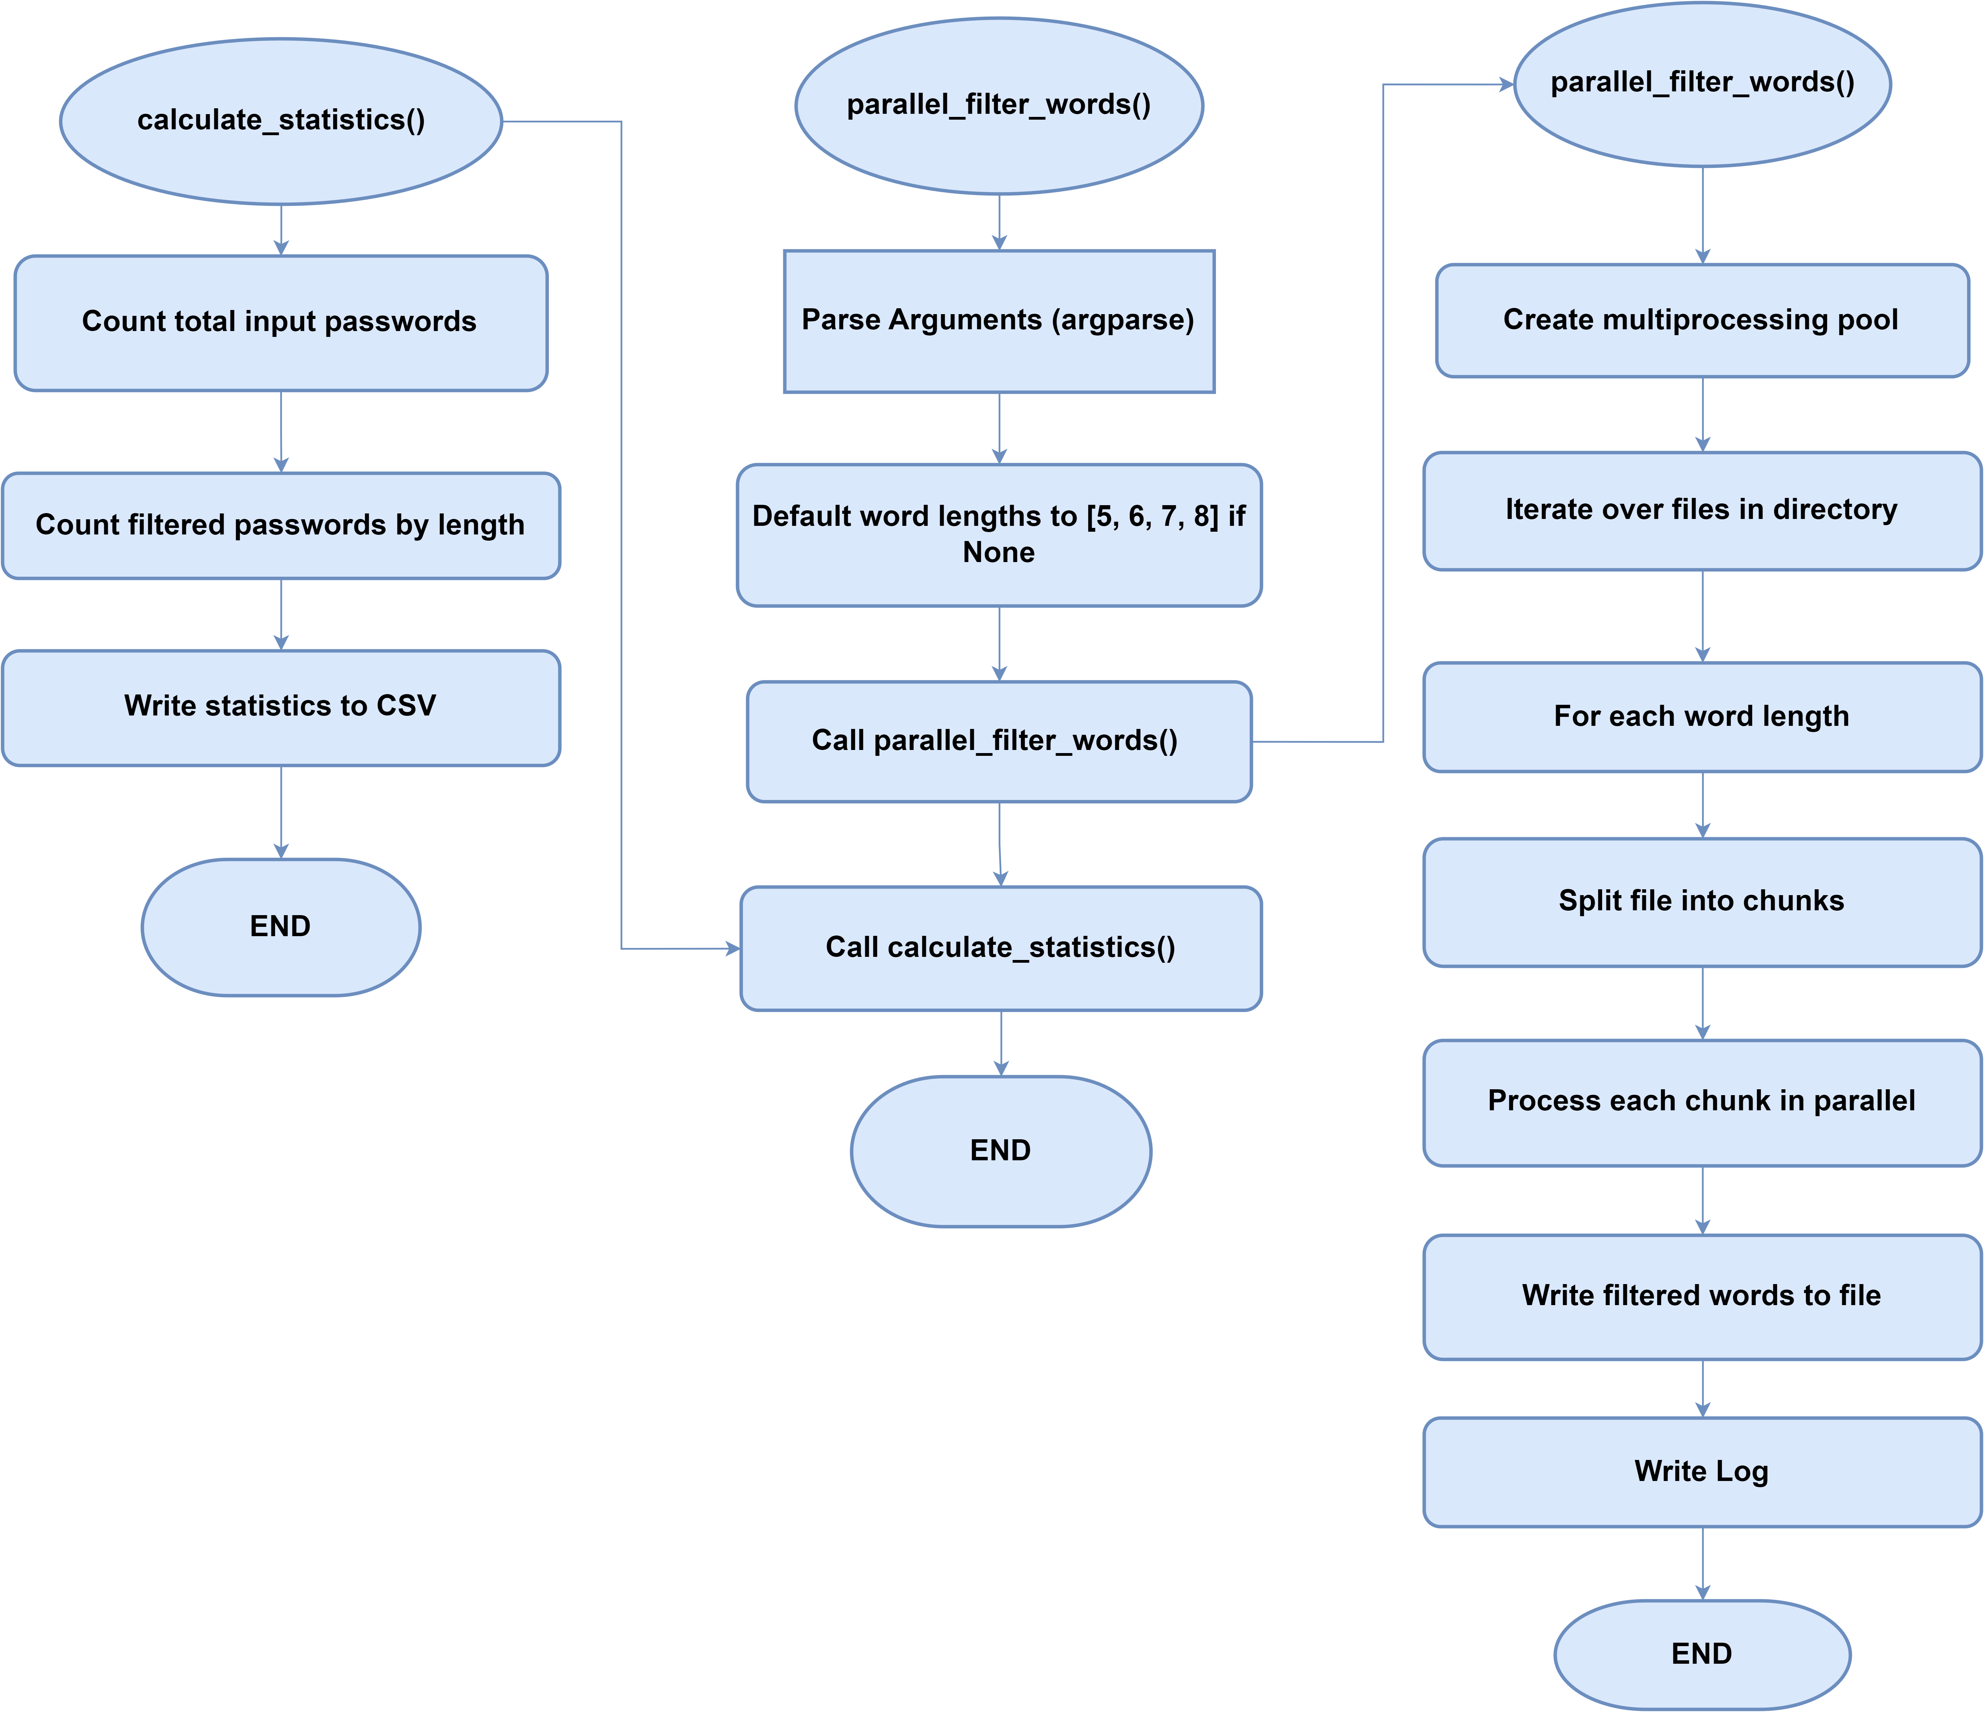
Data Filtration

Slide 27
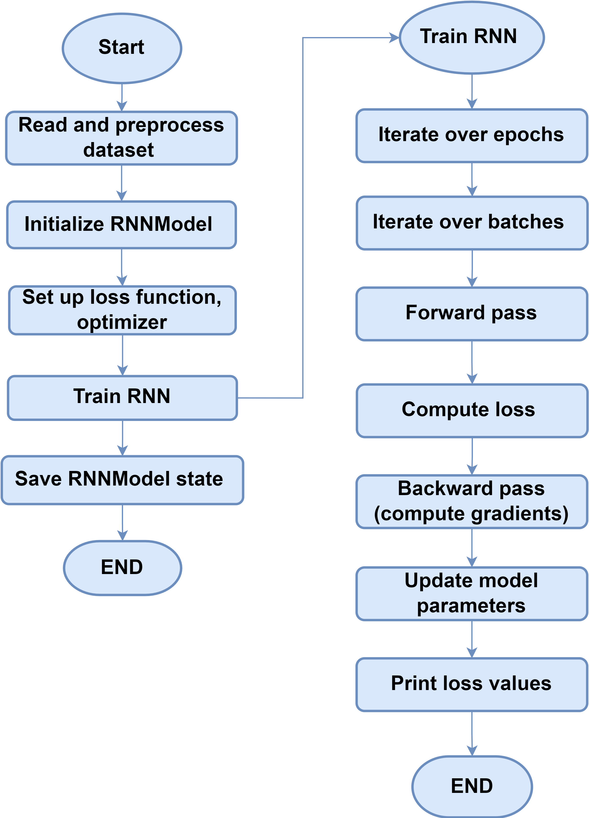
RNN Model Training

Slide 28
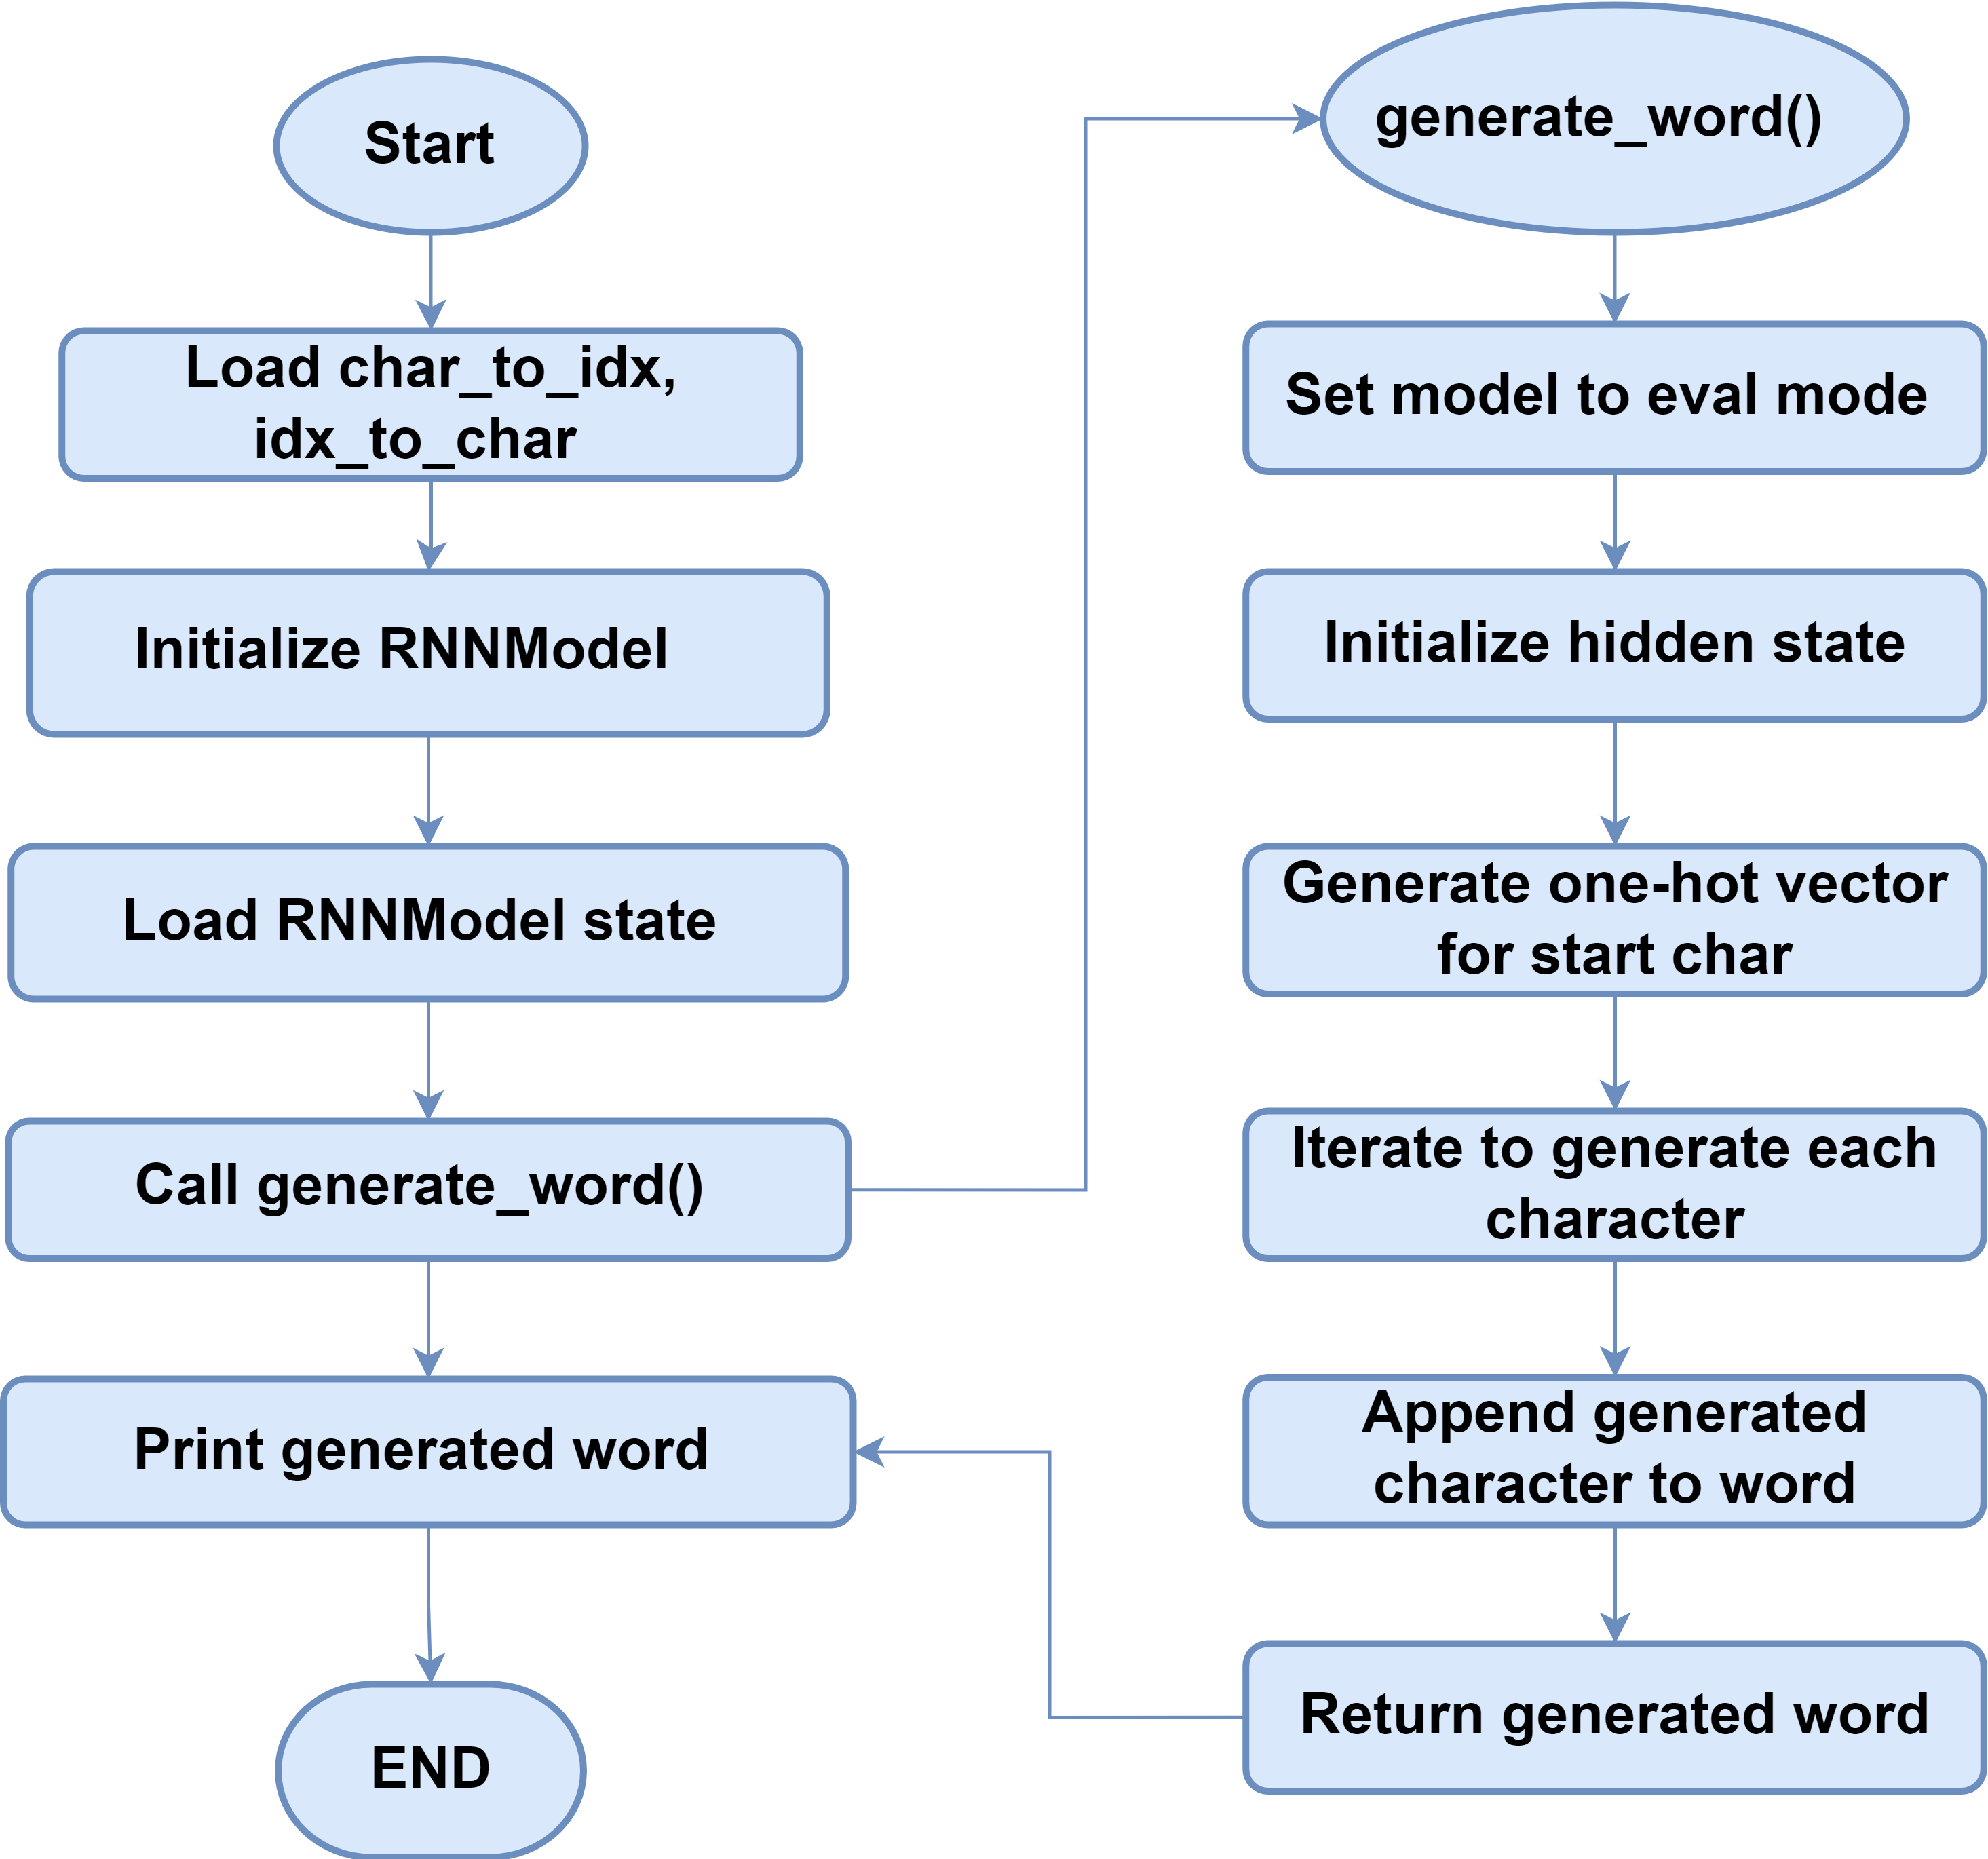
Generating Words through RNN Model

Slide 29
Training of RNN Model

Slide 30
Methodology
Downloaded the Datasets
Data splitting & Data filtering
Training of the AI model.
GUI creation
Integration of the AI model with multiple modules of the GUI

Slide 31
Datasets

Slide 32
Data Splitting

Slide 33
Data Filtration

Slide 34
RNN Model Training

Slide 35
Generating Words through RNN Model

Slide 36
Training of RNN Model

Slide 37
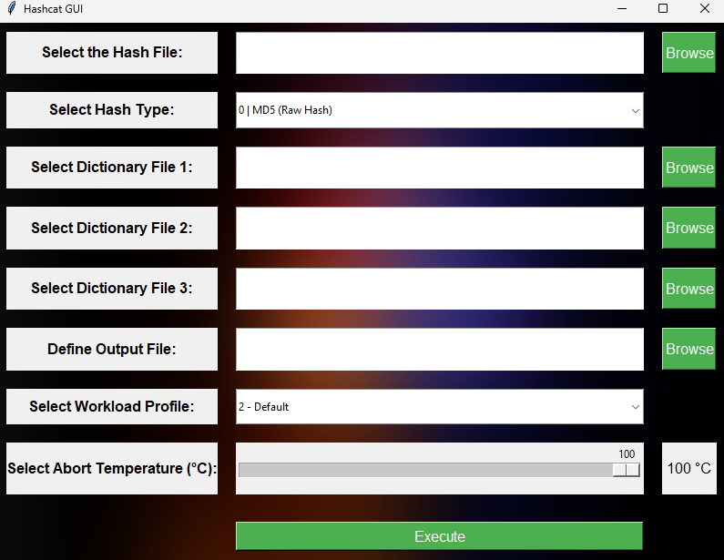
Password Cracking GUI

Slide 38
Key Points
User friendly GUI.
More than 500 Types of hashes can be selected.
Multiple dictionary files can be attached to begin the attack with.
Generates and saves an output file.
Can Select the workload, depending on the attack scenario.
Temperature control button, when too heated, process will be aborted.

Slide 39
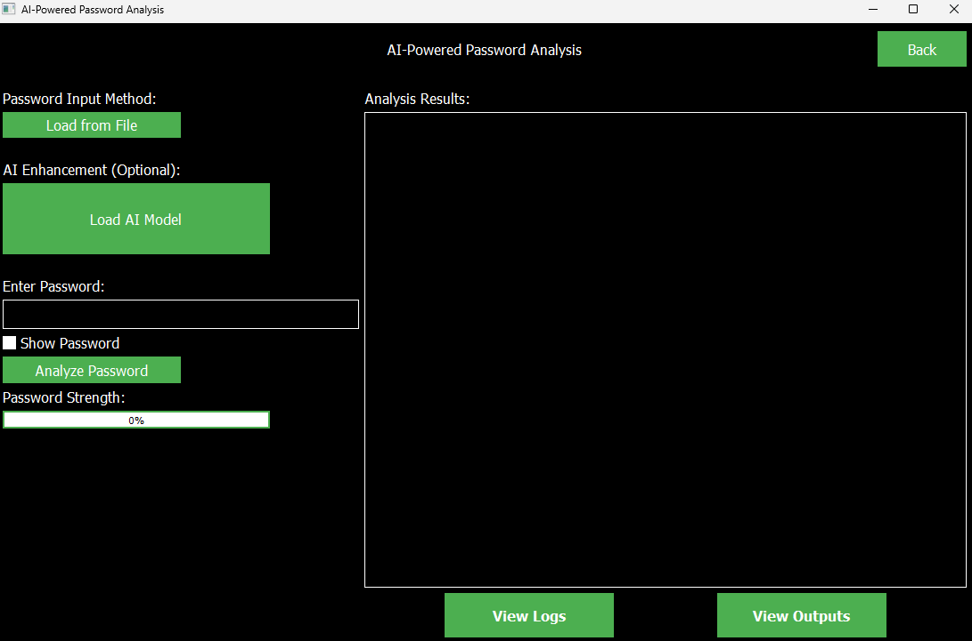
Password Analysis GUI

Slide 40
Key Points
User Friendly GUI.
Can select the newly created file for password analysis.
Can load trained AI model for password analysis.
Generates and saves an output file with detailed info e.g. timestamps, password strength.
Logs are generated too.
Password Strength can be viewed too.

Slide 41
Implementation Summary
Tools
Python
TensorFlow
PyTorch
Data management Tool
Visualization Tools
Visual Studio
Hashcat
CUDA Toolkit
Win SDK
Techniques:
Data Splitting and Filtering
RNN model
Training of the AI model
Improvement of the AI model
Comparative analysis of the Model

Slide 42
Experiments and Results Summary

Slide 44
Testing Summary

Slide 45
CONCLUSION AND OUTLOOK

Slide 46
Conclusion & Outlook
Password Cracking
Password Analysis
User-Friendly GUI
Continuous Enhancement
Adaptation to Evolving Threats
Promoting Responsible Use.

Slide 47
Any Questions?

